Slide 1
TOPIC-SAKILA DATABASE
CAPSTONE FINAL PROJECT –SPRINT 1 (SQL)
NAME: SANJAY SHOME
MENTOR: MR. ASHISH RAJPUT

Slide 2
INDEX
TITLE
SLIDE NO
1) business objective
2) data-driven question
3) SQL question
4) conclusion
2
3
5-11
12

Slide 3
BUSINESS OBJECTIVE
“Tasks related to managing rentals, customers, inventory, payments, and other aspects of a rental business in a controlled and educational environment”.

Slide 4
DATA DRIVEN QUESTION
1) Display the full names of all actors available in the database.
2.1) Display the number of times each first name appears in the database.
2.2) count of actors that have unique first names in the database.
3.1) Display the number of times each last names appears in the database.
3.2) Display all unique last names in the database.
4.1) Display the list of records for the movies with the Rating "R".
4.2) Display the list of records for the movies that are not Rated "R".
4.3) Display the list of records for the movies that are suitable for audience below 13 years of age.
5.1) Display the list of records for the movies where the replacement cost is up to $11.
5.2 ) Display the list of records for the movies where the replacement cost is between $11 and $20.
5.3) Display the list of records for all the movies in descending orders of their replacement costs.
6) Display the names of the TOP 3 movies with the greatest number of actors.
7) Display the titles of the movies starting with the letters 'K' and ‘Q’.
8) The fim 'Agent Truman' has been a great sucess,Display the name of all actors who appeared in this film.
9)Sales have been lagging among young families,so the mangement wants to promote family movies.identify all the movies categorized as family films.
10.1) Display the max,min,and average rental rate of movies based on their ratings.the output must be sorted in the descending order of the verage rental rates.
10.2) Display the movies in the descending order of their frequencies,so the mangement can maintain more copies of those movies.
11) Display in how many category the differencec between the average film replacement cost and the average rent in more than 15
12) Display the film category where the number of movies is greater than 70

Slide 5

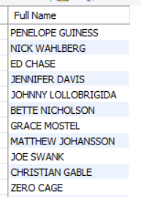
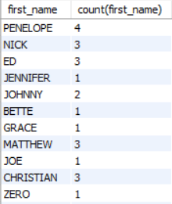
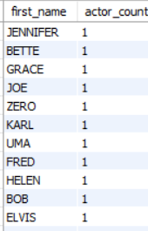
number of times each first name.
TASK1) full names of all actors.
TASK 2.1)
TASK 2.2: count of actors have unique first names
QUERY
QUERY
OUTPUT
OUTPUT
OUTPUT
INTERPRETATIONS
INTERPRETATIONS
INTERPRETATIONS
128 ROWS ARE THEIR IN THE OUTPUT
128 ROWS ARE THERE SHOWN IN THE OUTPUT
200 ROWS ARE SHOWN IN THE OUTPUT BY USING CONCAT FUNCTION

Slide 6

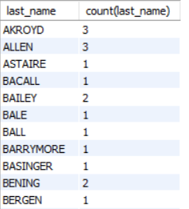

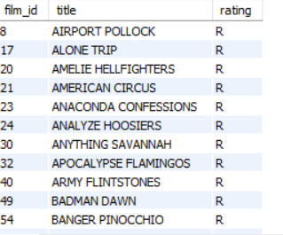
TASK 3.1: number of times each last names
QUERY
TASK 3.2
Display all unique last names
TASK 4.1
list of records for the movies with the Rating "R".
OUTPUT
OUTPUT
OUTPUT
INTERPRETATION
INTERPRETATION
INTERPRETATION
THERE ARE 121 ROWS LAST NAMES FROM ACTORS
THERE ARE 195 ROWS LIST OF RECORDS FOR THE MOVIES
THERE ARE 121 ROWS COUNT OF LAST NAMES

Slide 7


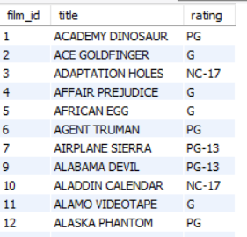
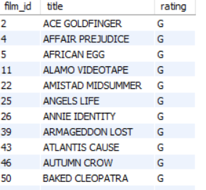
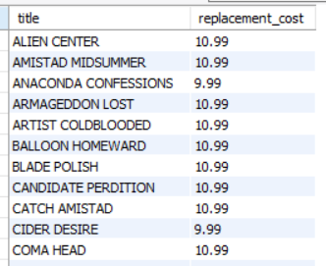
TASK4.2 Display records movies not Rated "R".
TASK 5.1
QUERY
TASK 4.3
display records movies where the replacement cost is up to $11.
display records movies for audience below 13 years age.
OUTPUT
OUTPUT
OUTPUT
INTERPRETATION
INTERPRETATION
INTERPRETATION
THERE ARE 805 ROWS MOVIE TITLE OTHER THAN R
THERE ARE 178 ROWS BELOW 13 YEARS AGE
THERE ARE 90 MOVIES TITLE COST IS UP TO $ 11

Slide 8
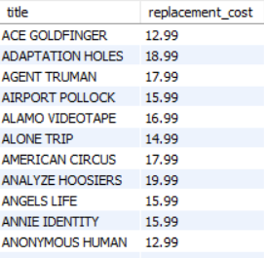
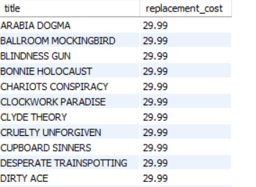
TASK 5.2 movies replacement cost between $11 and $20.
QUERY
Task 5.3 Display records movies descending orders replacement costs.
QUERY
OUTPUT
OUTPUT
INTERPRETATION
INTERPRETATION
THERE ARE 424 ROWS MOVIE TITLE REPLACEMENT COST
THERE ARE 1000 ROWS ALL THE REPLACEMENT COST IN DESC ORDER

Slide 9
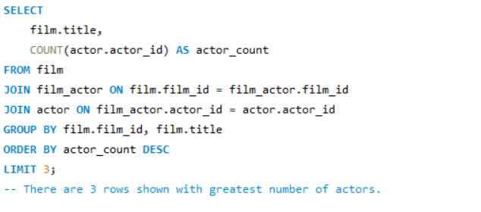
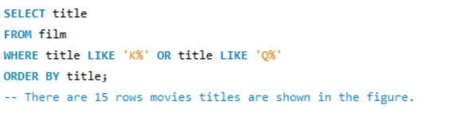
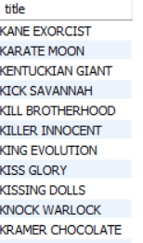

TASK 6
names TOP 3 movies greatest number of actors.
Display titles movies starting letters 'K' and 'Q'.
TASK 7
QUERY
QUERY
OUTPUT
OUTPUT
INTERPRETATION
INTERPRETATION
THERE ARE 3 ROWS GREATEST NO.OF MOVIES
THERE ARE 15 ROWS MOVIES TITLE SHOWN

Slide 10
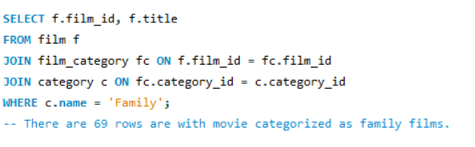
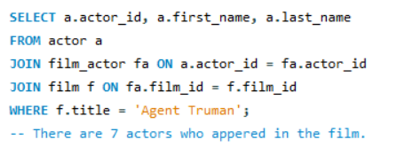
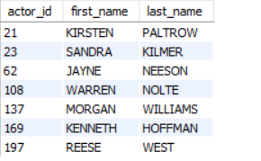
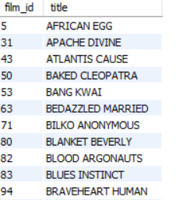
identify all the movies categorized as family films.
TASK9
TASK8
Display the name actors fim 'Agent Truman' who appeared film.
QUERY
QUERY
OUTPUT
OUTPUT
INTERPRETATION
INTERPRETATION
THERE ARE 7 ROWS ACTOR ID FILM AGENT TRUMAN
THERE ARE 69 ROWS MOVIE CATEGORIZED AS FAMIY FILMS

Slide 11
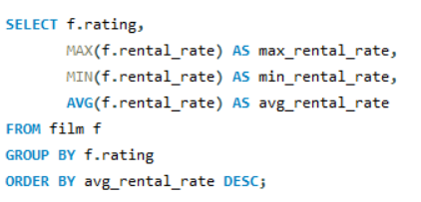
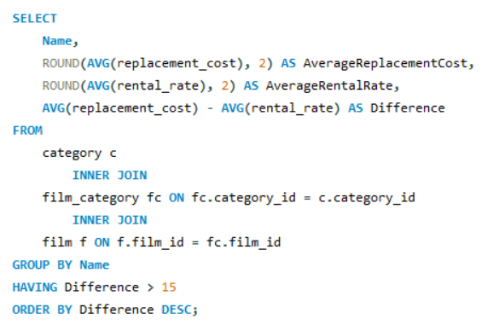
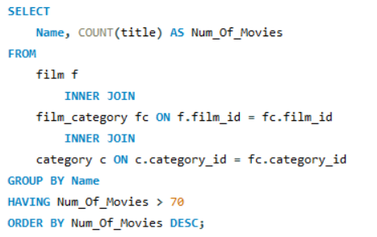
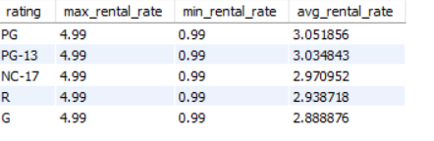
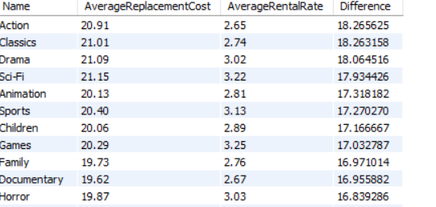

TASK 10
rental rate of movies based on their ratings.
QUERY
TASK11
avg film replacement cost and avg rent more than 15
QUERY
film category number of movies > 70
TASK12
QUERY
OUTPUT
OUTPUT
INTERPRETATION
INTERPRETATION
INTERPRETATION
THERE ARE 2 ROWS SHOWN IN THE NUMBER OF MOVIES
5 ROWS ARE SHOWN IN O/P
THERE ARE 16 ROWS AVG FILM AVG RENTAL RATES

Slide 12
CONCLUSION
The Sakila database have a wide range of movies across different genres and categories. Typically, in rental stores, movie rental rates, may vary based on factors such as the popularity of the film, its release date, genre, and duration of rental (e.g., daily or weekly rates).
The database schema typically includes tables like film, actor, category, customer, rental, payment, etc.

